Slide 1
CHAPTER 9
Measurement: Scaling, Reliability, Validity
TOPICS DISCUSSED
SCALING TECHINEQUES FREQUENTLY USED
Rating Scales
Ranking Scales
GOODNESS OF MEASURES
Reliability
Validity

Slide 2
Rating Scales
There are two main categories of attitudinal scales-the rating scale and the ranking scale. Rating scales have several response categories and are used to elicit responses with regard to the object, event, or person studied. Ranking scales, on the other hand , make comparisons between or among objects, events, or person and elicit the preferred choices and ranking among them.
The following rating scales are often used in organizational research:
Dichotomous scale
Category scale
Likert scale
Numerical scales
Semantic differential scale
Itemized rating scale
Fixed or constant sum rating scale
Stapel scale
Graphic rating scale
Consensus scale

Slide 3
Rating Scales (contd..)
Dichotomous scale
This scale is used to elicit a YES or NO answer. Note that a nominal scale is used to elicit the response.
Example: Do you own a car? Yes No
Category scale
This uses multiple items to elicit a single response. This also uses the nominal scale.
Example: Where in Punjab do you reside? Lahore, Multan,Faisalabad
Likert scale
The Likert scale is designed to examine how strongly subjects agree or disagree with statements on a 5-point scale with following anchors.
STRONGLY DISAGREE NEITHR AGREE AGREE STRONGLY DISGREE NOR DISAGREE AGREE
1 2 3 4 5

Slide 4
Rating Scales (contd..)
Example: Using the preceding Likert scale, state the extent to which you agree with each of the following statements:
My work is very interesting 1 2 3 4 5
I am not engrossed in my work
all day 1 2 3 4 5
Life without my work will be dull 1 2 3 4 5
Semantic differential scale
Several bipolar attributes are identified at the extremes of the scale, and respondents are asked to indicate their attitudes, on what may be called a semantic space, toward a particular individual, object, or event on each of the attributes. The bipolar adjectives used, for instance, would employ such terms as Good-Bad; Strong-Weak; Hot-Cold. The semantic differential scale is used to assess respondents’ attitudes toward a particular brand, advertisement, object or individual. The responses can be plotted to obtain a good idea of their perceptions. This is treated as an interval scale.

Slide 5
Rating Scales (contd..)
Example:
Responsive - - - - - Unresponsive
Beautiful - - - - - - Ugly
Courageous - - - - - Timid
Numerical scales
The numerical scale is similar to the semantic differential scale, with the difference that numbers on a 5-point or +point scale are provided, with bipolar adjectives at both ends. This is also an interval scale.
Example: How pleased are you with your new real estate agent?
Extremely Pleased 7 6 5 4 3 2 1 Extremely Displeased
Itemized rating scale
A 5-point or 7-point scale with anchors, as needed, is provided for each item and the respondent states the appropriate number on the side of each item, or circles the relevant number against each item. The responses to the items are then summated. This uses an interval scale.

Slide 6
Rating Scales (contd..)
Example: Respond to each item using the scale below, and indicate your response number on the line by each item.
I will be changing my job within the next 12 months ___
I will take on new assignments in the near future. ___
It is possible that I will be out of this organization within
next 12 months ___
1=Very Unlikely
2=Unlikely
3=Neither Likely Nor Unlikely
4=Likely
5=Very Likely
Note that the above is a balanced rating scale with a neutral point.

Slide 7
Rating Scales (contd..)
Fixed or constant sum rating scale
The respondents are here asked to distribute a given number of points across various items. This is more in nature of an ordinal scale.
Example: In choosing a toilet soap, indicate the importance you attach to each of the following five aspects by allotting points for each to total 100 in all.
Fragrance ____
Color ____
Shape ____
Size ____
Texture of lather____
Total points 100

Slide 8
Rating Scales (contd..)
Stapel Scale
This scale simultaneously measures both direction and intensity of the attitude toward the items under study. The characteristic of interest to the study is placed at the center and a numerical scale ranging, say, from +3 to -3, on either side of the item illustrated below. This gives an idea of how close or distant the individual response to the stimulus is. Since this does not have an absolute zero point, this is an interval scale.
Example:
State how you would rate your supervisor’s abilities with respect to each of the characteristics mentioned below, by circling the appropriate number.
+3 +3 +3
+2 +2 +2
+1 +1 +1
Adopting Modern Product Innovation Interpersonal skills
Technology
-1 -1 -1
-2 -2 -2
-3 -3 -3

Slide 9
Rating Scales (contd..)
Graphic rating scale
A graphical representation helps the respondents to indicate on this scale their answers to a particular question by placing a mark at the appropriate point on the line. This is an ordinal scale, though the following example might appear to make it look like an interval scale.
Example:
On a scale of 1 to 10, Excellent
How would you rate your All right
Supervisor? Very bad

Slide 10
Ranking Scales
Ranking scales are used to tap preferences between two or among more objects or items (ordinal in nature). However such ranking may not give definitive clues to some of the answers sought. Alternate methods used are the paired comparisons, Forced choice and the comparative scale.
Paired Comparison
This scale is used when, among a small number of objects, respondents are asked to choose between two objects at a time. This helps to assess preferences. If, for instance, in the previous example, during the paired comparisons, respondents consistently show a preference for product one over products two, three, and four, the manager reliably understands which product line demands his utmost attention.

Slide 11
Ranking Scales (contd..)
Forced Choice
The forced choice enables respondents to rank objects relative to one another, among the alternatives provided. This is easier for the respondents, particularly if the number of choices to be ranked is limited in number.
Example: Rank the following magazines that you would like to subscribe to in the order of preference, assigning 1 for the most preferred choice and 3 for the least preferred.
Fortune __
People __
Time __

Slide 12
Ranking Scales (contd..)
Comparative Scale
The comparative scale provides a benchmark or a point of reference to assess attitudes toward the current object, event, or situation under study.
Example: In volatile financial environment, compared to stocks, how wise or useful is it to invest in Treasury bonds? Please circle the appropriate response.
More Useful About the same Less Useful
1 2 3 4 5
Rating scales are used to measure most behavioral concepts. Ranking scales are used to make comparisons or rank the variables that have been tapped on a nominal scale

Slide 13
Goodness of Measures
After operationally defining variables and applying different scaling techniques it is important to make sure that the instrument that we have developed to measure a particular concept is indeed accurately measuring the variable and that in fact we are actually measuring the concept that we set out to measure. In some way we need to assess the goodness of the measures developed. That is, we need to be reasonably sure that the instruments we use in our research do indeed measure the variables they are supposed to and that they measure them accurately. This is done first by item analysis and then the reliability and validity of the measures is established.
Item Analysis
Item analysis is done to see if the items in the instrument belong there or not. Each item is examined for its ability to discriminate between those subjects whose total scores are high and those with low scores. In item analysis the means between the high score group and the low score group are tested to detect significant differences through the t-value. The items with high t-value are then included in the instrument. Thereafter tests for the reliability of the instrument are done and the validity of the measure is established.

Slide 14
Reliability
The reliability of a measure indicates the extent to which it is without bias and hence ensures consistent measurement across time and across the various items in the instrument. In other words, the reliability of a measure is an indication of the stability and consistency with which the instrument measures the concept and helps to asses the “goodness” of a measure
Stability of Measures
The ability of a measure to remain the same over time despite uncontrollable testing conditions or the state of the respondents themselves is indicative of its stability and low vulnerability to changes in the situation. This attests to its goodness because the concept is stably measured no matter when it is done. Tests of stability are test-retest reliability and parallel form reliability.

Slide 15
Reliability (contd..)
Test-retest Reliability
The reliability coefficient obtained with the repetition of the same measure on a second occasion is called test-retest reliability. If a questionnaire is administered to a set of respondents now and again to the same respondents several weeks to six months later then the correlation between the scores obtained at the two different times from one and the same set of respondents is called the test-retest coefficient. The higher it is the better the test-retest reliability.
Parallel form Reliability
When responses on two comparable sets of measures tapping the same construct are highly correlated we have parallel form reliability. Both forms have similar items and the same response format. The only changes being the wordings and the order or sequence of the questions.

Slide 16
Reliability (contd..)
Internal Consistency of Measures
The internal consistency of measures is indicative of the homogeneity of the items in the measure that tap the construct. In other words, the items should be capable of independently measuring the same concept so that the respondents attach the same overall meaning to each of the items. This can be done through inter-item consistency reliability and split-half reliability tests.
Inter-item consistency reliability
This is a test of the consistency of respondents’ answers to all the items in a measure. To the degree that the items are independent measures of the same concept, they will be correlated with one another.
Split-half reliability
The split-half reliability reflects the correlations between two halves of the instrument.

Slide 17
Validity
If an instrument measures what it claims to measure then it is said to be a valid instrument. Several types of validity tests are used to test the goodness of measures. Validity tests are grouped under three broad headings; Content Validity, Criterion-Related Validity and Construct Validity.
Content Validity
This ensures that the measure includes an adequate and representative set of items that tap the concept. Content validity is a function of how well the dimension elements of a concept have been delineated. A panel of judges can attest to the content validity of the instrument. This is also called Face Validity.
Criterion-Related Validity
This is established when the measure differentiates individuals on a criterion it is expected to predict. This can be done by concurrent validity or predictive validity.

Slide 18
Validity (contd..)
Concurrent validity is established when the scale discriminates individuals who are known to be different; that is, they should score differently on the instrument.
Predictive validity indicates the ability of the measuring instrument to differentiate among individuals with reference to a future criterion eg. If an aptitude or ability test administered to employees at the time of recruitment is to differentiate individuals on the basis of their future job performance, then those who score low on test should be poor performers and those with high scores good performers.
Construct Validity
Construct validity testifies to how well the results obtained from the use of the measure fit the theories around which the test is designed. This is assessed through convergent and discriminant validity.
Convergent validity is established when the scores obtained with two different instruments measuring the same concept are highly correlated.
Discriminant validity is established when based on theory two variables are predicted to be uncorrelated and the scores obtained by measuring them are indeed empirically found to be so.

Slide 19
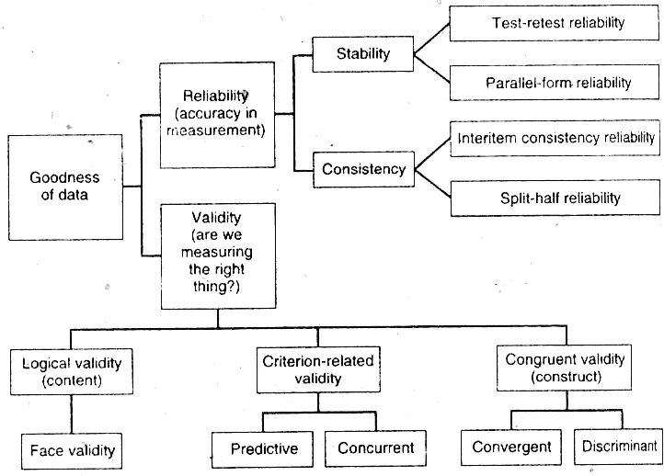
Testing goodness of measures: forms of reliability and validity

Slide 20
Types of Validity
Validity | Description
Content validity | Does the measure adequately measure the concept
Face validity | Do “experts” validate that the instrument measures what its name suggests it measures?
Criterion-related validity | Does the measure differentiate in a manner that helps to predict a criterion variable?
Concurrent validity | Does the measure differentiate in a manner that helps to predict a criterion variable currently?
Predicative validity | Does the measure differentiate individuals in a manner as to help predict a future criterion?
Construct validity | Does the instrument tap the concept as theorized?
Convergent validity | Do two instruments measuring the concept correlate highly?
Discriminant validity | Does the measure have a low correlation with a variable that is supposed to be unrelated to this variable?

